Slide 1
Accelerate Delaware
Team 13

Slide 2
Beginning Ideas
Profile interface (company and personal)
Location services; zip code
Networking and social media
Calendar of events
Invites
Promotions and saved offers
Point system

Slide 3
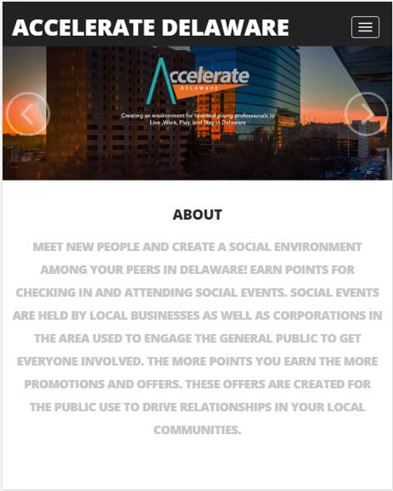
Welcome Screen
Logo
Login
About

Slide 4
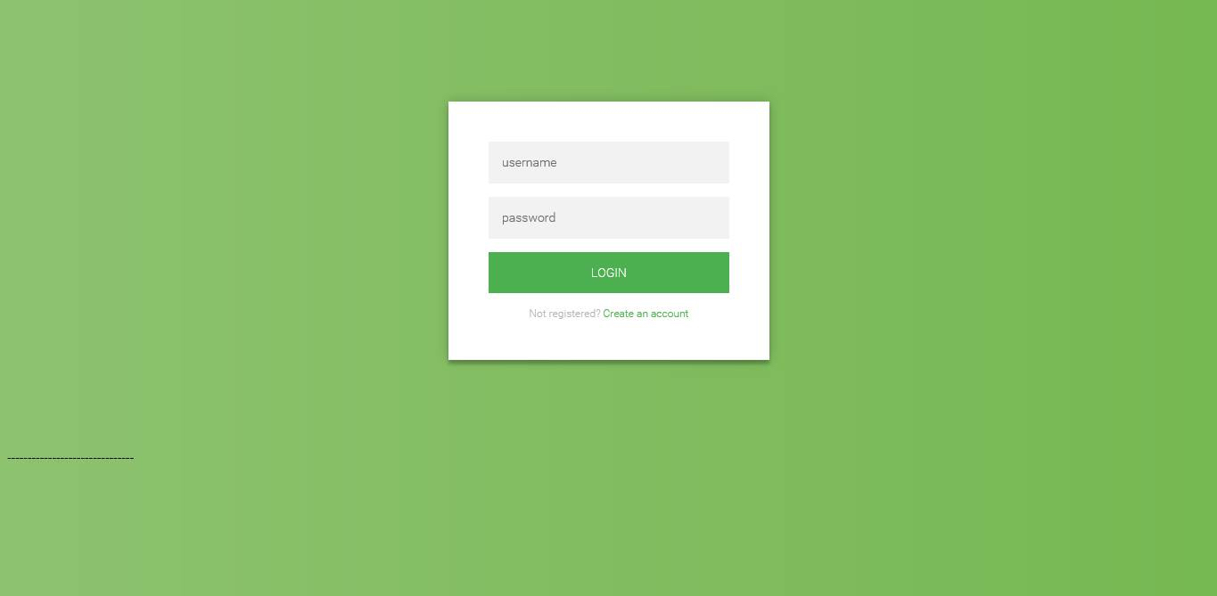
Login Screen
Create account
Sign in with facebook/other social media

Slide 5
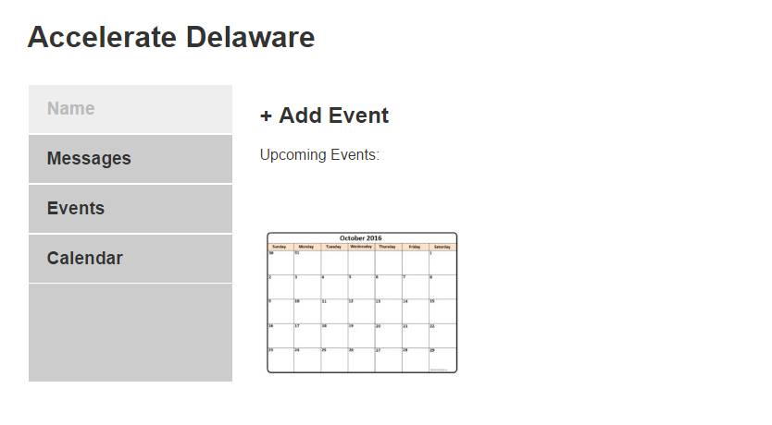
Opening Screen
Dashboard of events
Calendar

Slide 6
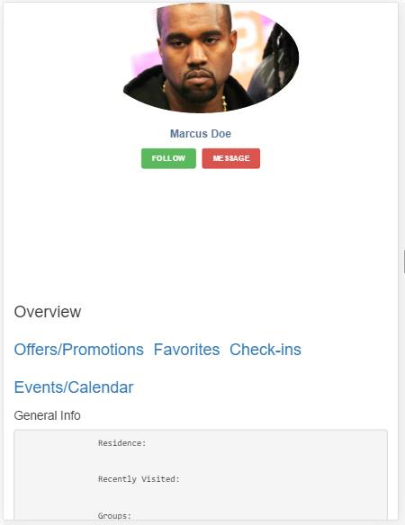
Profiles
User profile
Specialized for user

